Slide 1
Agenda
Motivation for sequence learning models
Introduction to RNNs
RNN application to Image Captioning

Slide 2
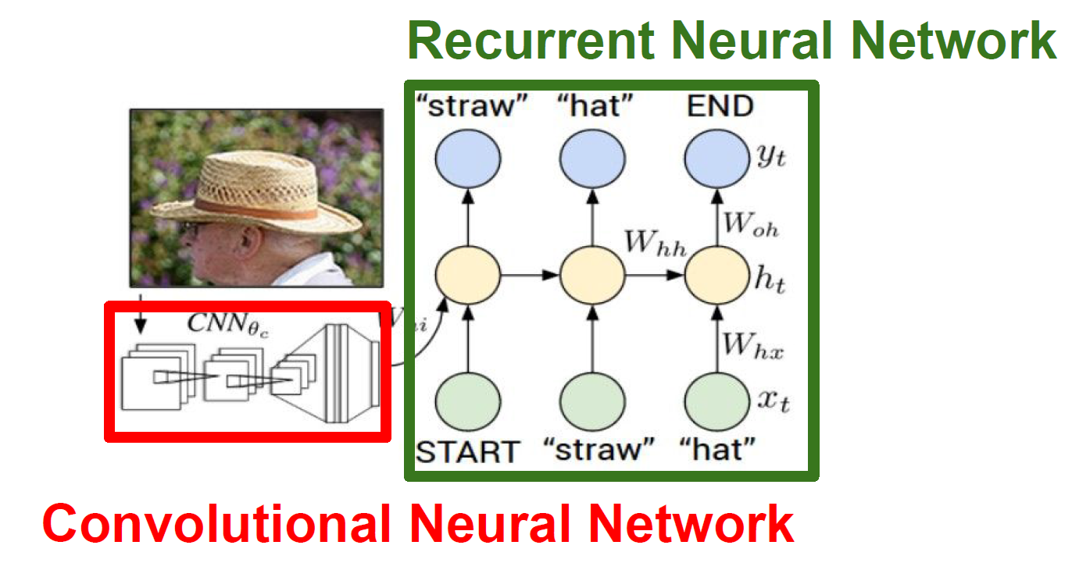
CNN+RNN for image captioning

Slide 3
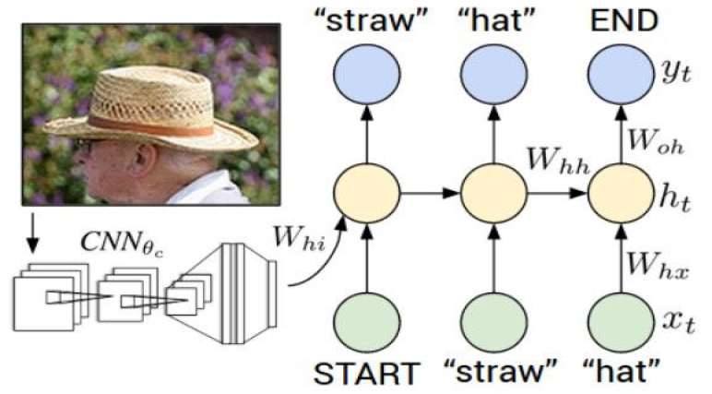
Image Captioning

Slide 4
LSTMs and other RNN Variants
Manish Gupta
Visiting Faculty at ISB
Senior Applied Scientist at Microsoft, India
Adjunct Faculty at IIIT-H
Credits: Stanford CS224D course, CS231N Stanford course, Geoffrey Hinton’s course, http://deeplearning.net/tutorial,
http://colah.github.io/posts/2015-08-Understanding-LSTMs/

Slide 5
Agenda
RNN applications and variants
LSTM

Slide 6
Agenda
RNN applications and variants
LSTM

Slide 7
CNN+RNN for image captioning

Slide 8
Image Captioning

Slide 9
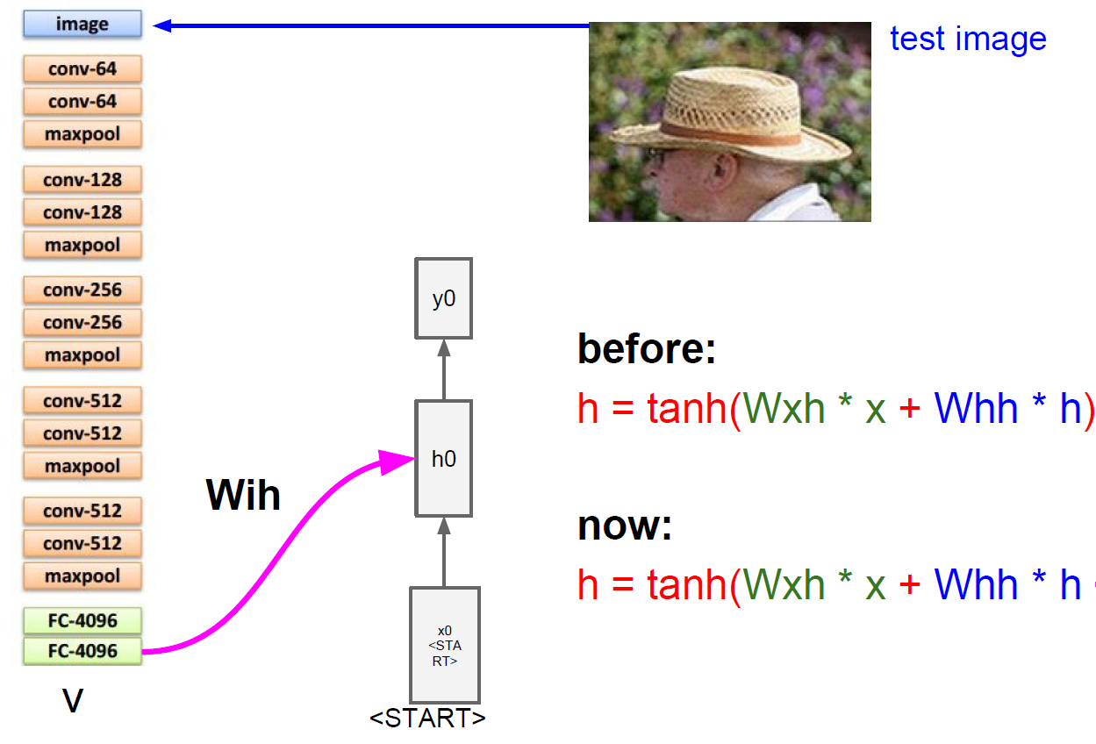
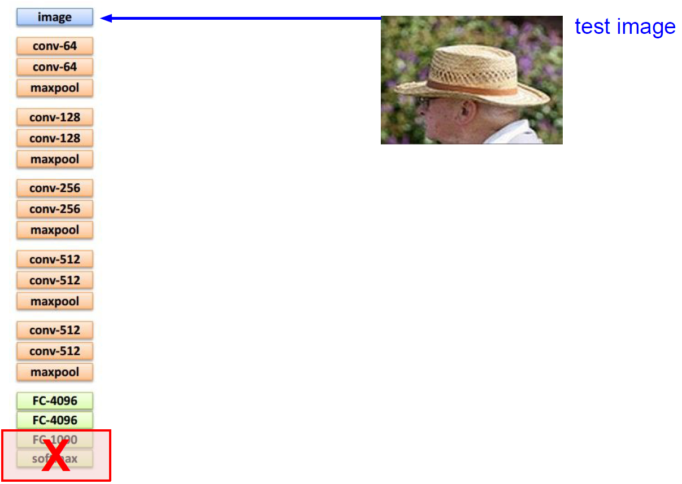
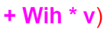
Image Captioning

Slide 10
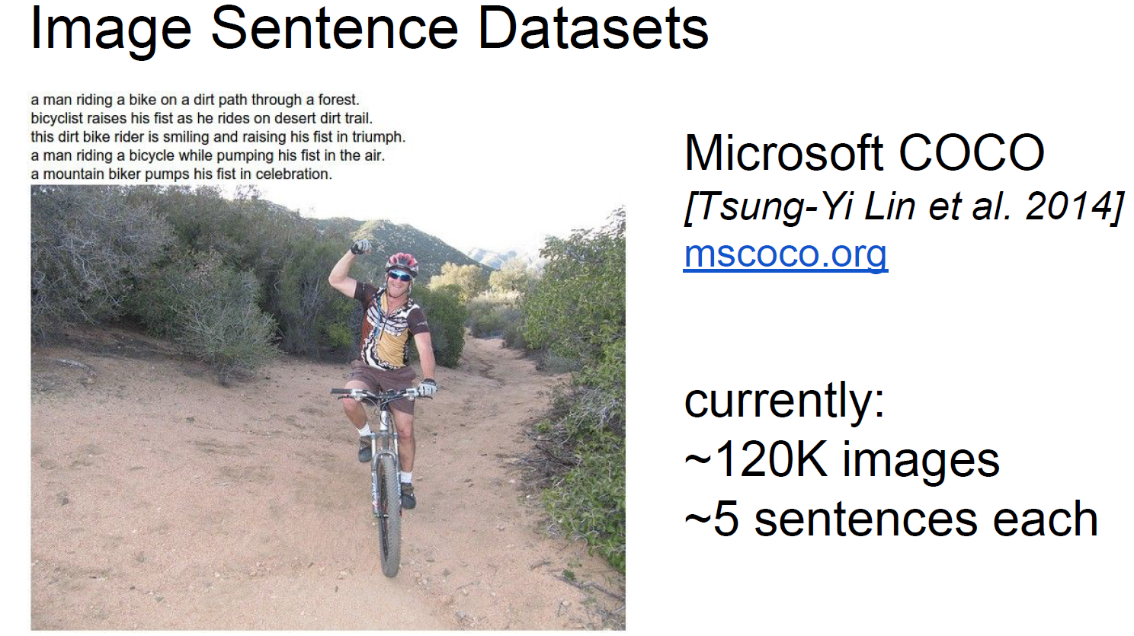
Is there a dataset to learn this thing?

Slide 11


Slide 12
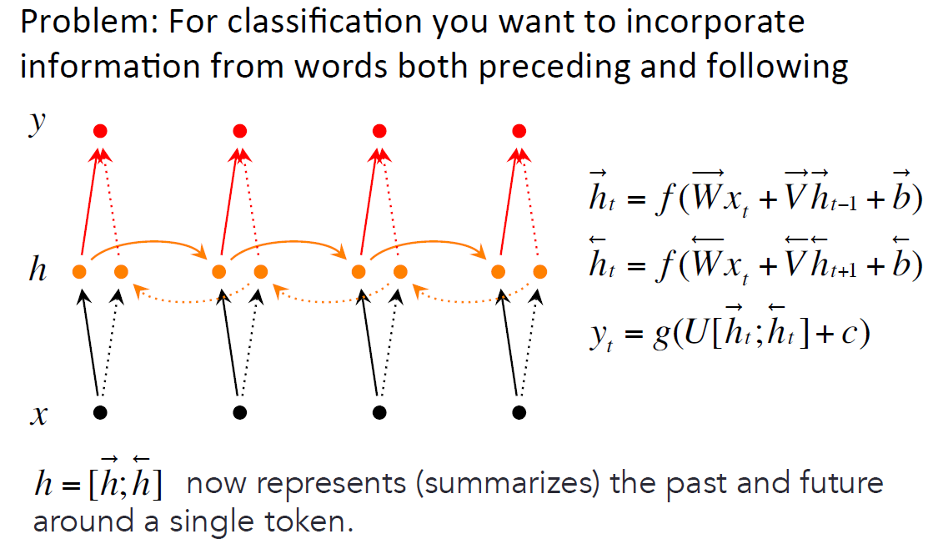
Bidirectional RNNs
To maintain two hidden layers at any time, this network consumes twice as much memory space for its weight and bias parameters.

Slide 13
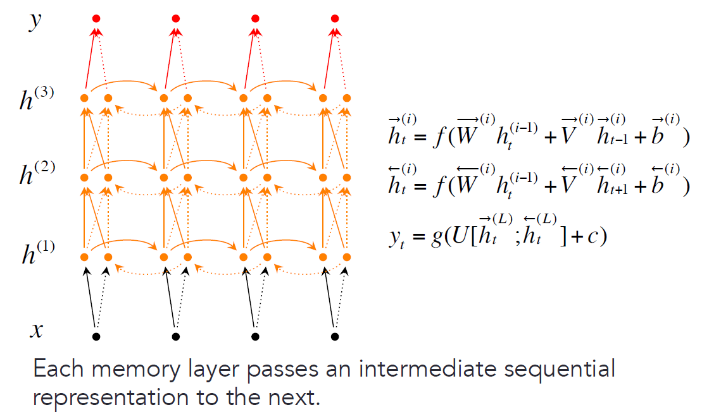
Deep Bidirectional RNNs
At time-step t each intermediate neuron receives one set of parameters from the previous time-step (in the same RNN layer), and two sets of parameters from the previous RNN hidden layer; one input comes from the left-to-right RNN and the other from the right-to-left RNN.

Slide 14
Memory based models
Better units than RNNs.
Beyond the extensions discussed so far, RNNs have been found to perform better with the use of more complex units for activation.
Although RNNs can theoretically capture long-term dependencies, they are very hard to actually train to do this.
Main ideas
keep around memories to capture long distance dependencies.
allow error messages to flow at different strengths depending on the inputs.

Slide 15
Agenda
RNN applications and variants
LSTM

Slide 16
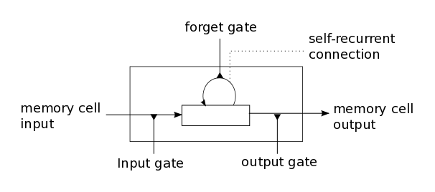
Long short-term memory (LSTM)
Intuition: memory cells can keep information intact, unless inputs makes them forget it or overwrite it with new input.
Cell can decide to output this information or just store it.

Slide 17
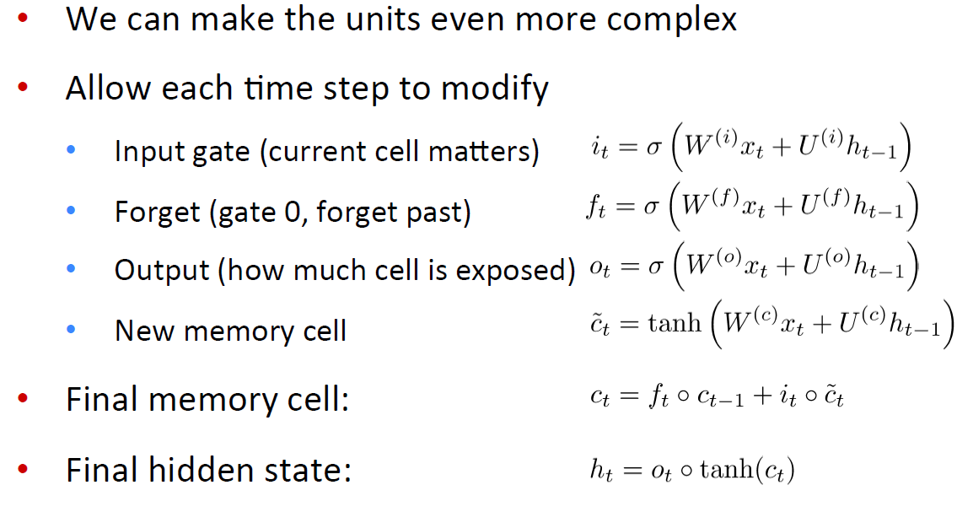
Long Short-term memories (LSTMs)

Slide 18
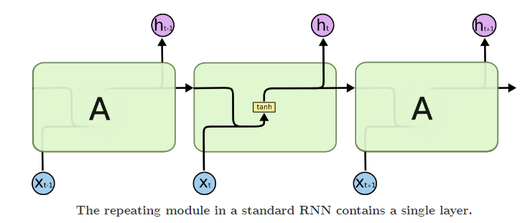
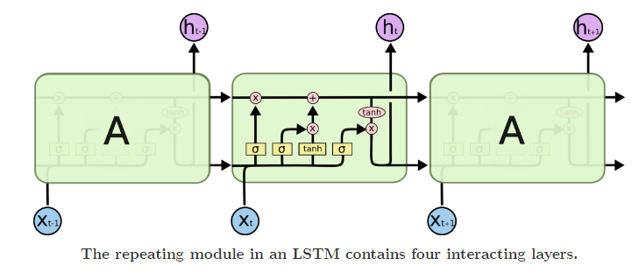
RNN vs LSTM

Slide 19
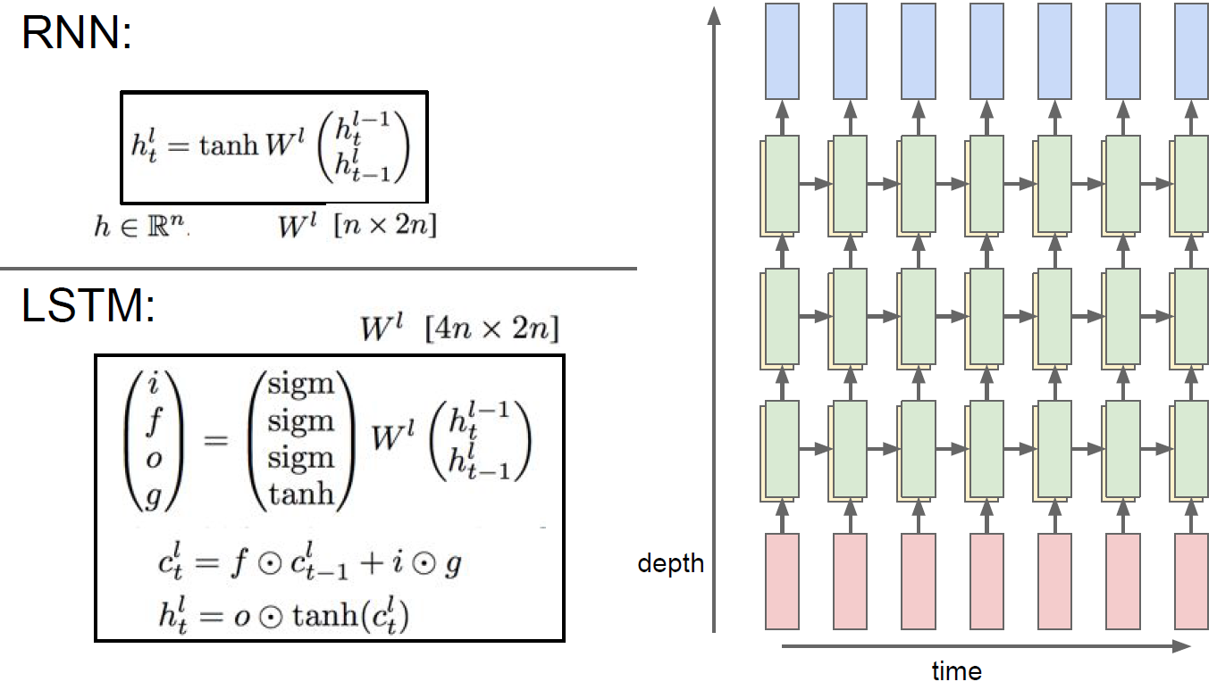
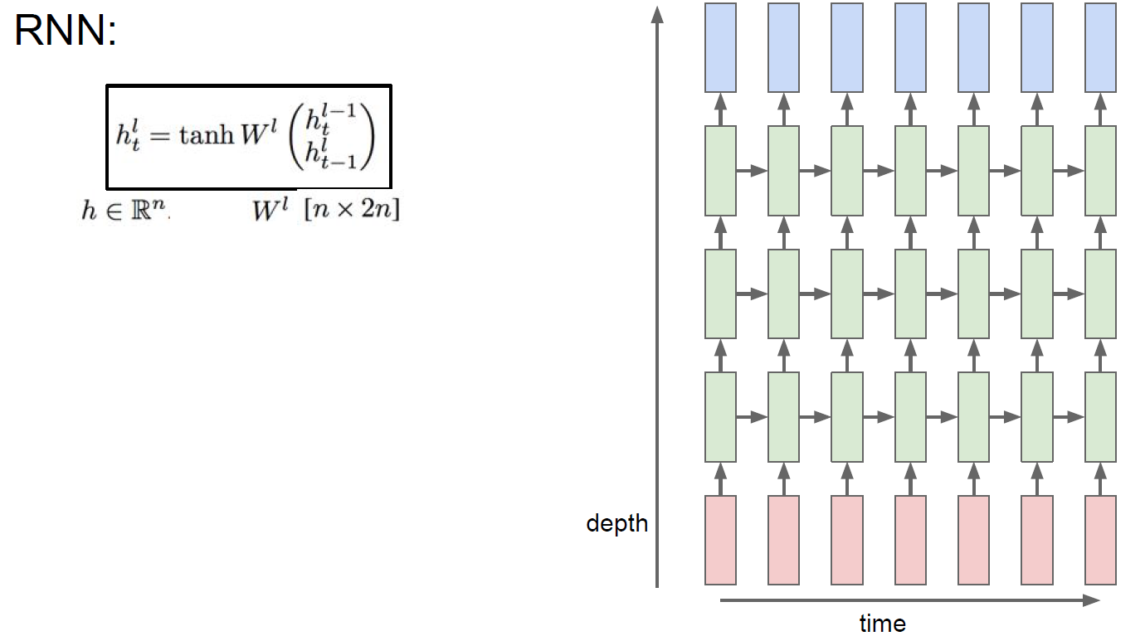
Deep RNNs vs Deep LSTMs

Slide 20
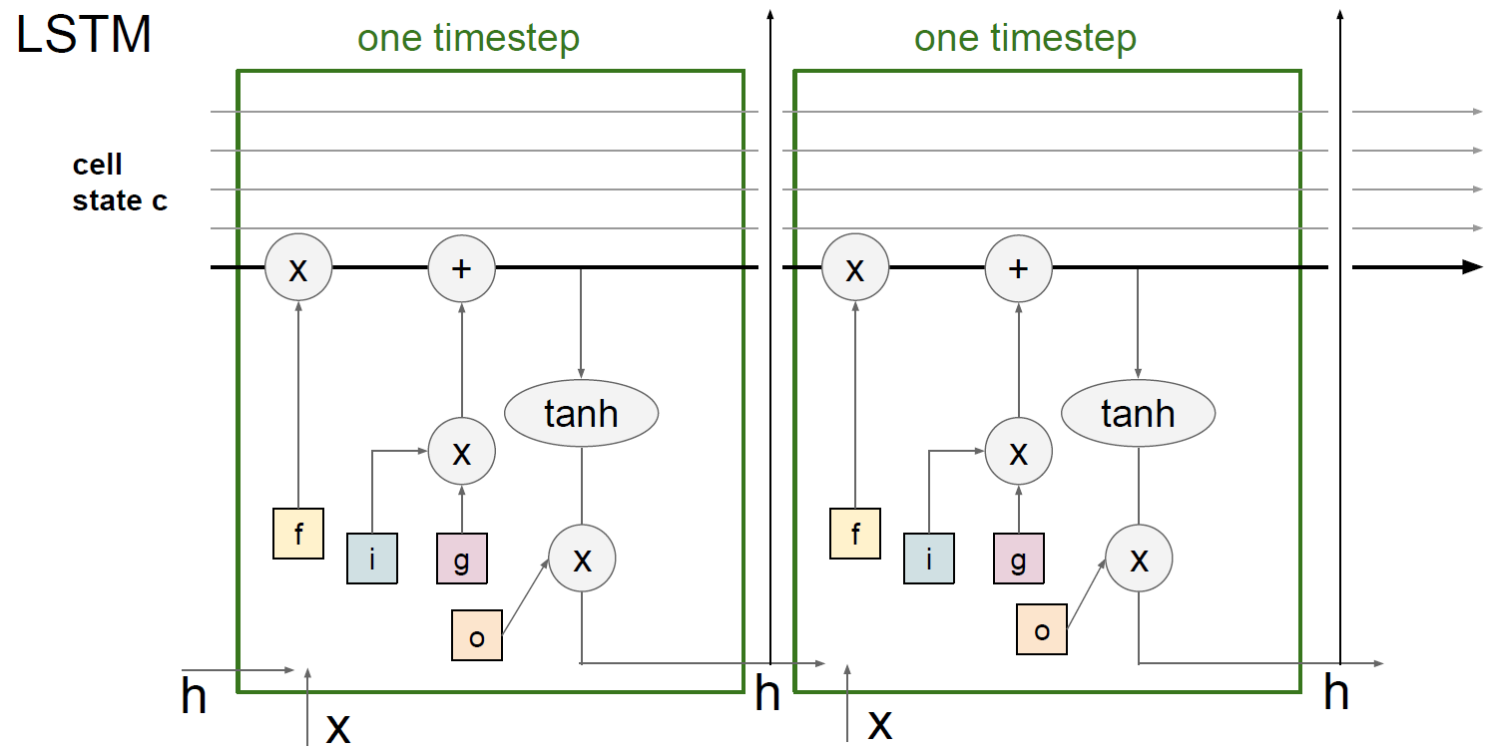
LSTM detailed description

Slide 21
Take-aways
Recurrent Neural Networks are powerful in modeling sequence data.
But they have the vanishing/exploding gradient problem.
GRUs and LSTMs are even better.
Really useful in many real world applications like image captioning, opinion mining and machine translation.

Slide 22
References
hip://www.wildml.com/2015/09/recurrent-neural-networks-tutorial-part-1-introduction-to-rnns/
hip://karpathy.github.io/2015/05/21/rnn-effectiveness/
hip://colah.github.io/posts/2015-08-Understanding-LSTMs/
hip://deeplearning.cs.cmu.edu/pdfs/Hochreiter97_lstm.pdf
hip://jeffdonahue.com/lrcn/
Multiple Object Recognition with Visual Aiention Jimmy Ba, Volodymyr Mnih, Koray Kavukcuoglu
DRAW: A Recurrent Neural Network For Image Generation Karol Gregor, Ivo Danihelka, Alex Graves, Danilo Jimenez Rezende, Daan Wierstra
Empirical Evaluation of Gated Recurrent Neural Networks on Sequence Modeling. Junyoung Chung, Caglar Gulcehre Kyung, Hyun Cho, Yoshua Bengio
An Empirical Exploration of Recurrent Network Architectures. Rafal Jozefowicz, Wojciech Zaremba, Ilya Sutskever
https://github.com/kjw0612/awesome-rnn#theory

Slide 23
Encoder-decoder models for machine translation
The encoder steps through the input time steps and encodes the entire sequence into a fixed length vector called a context vector.
Big RNNs trained end-to-end.
Ilya Sutskever, et al. “Sequence to Sequence Learning with Neural Networks” using LSTMs.
Kyunghyun Cho, et al. “Learning Phrase Representations using RNN Encoder–Decoder for Statistical Machine Translation”.
Notes:
Researchers at Google & Montreal develop a new approach for MT
What is NMT?
A large neural network trained end-to-end.
Reads the entire source sentence.
Produces a translation one word at a time.
Advantages
Input sequence, output sequence
Generalization: source-conditioned LMs.
30, 50-gram LMs
Dimensionality reduction: no gigantic PTs or LMs.
Simple beam-search decoder.

Slide 24
Encoder-decoder models for machine translation
The encoder steps through the input time steps and encodes the entire sequence into a fixed length vector called a context vector.
Big RNNs trained end-to-end.
Ilya Sutskever, et al. “Sequence to Sequence Learning with Neural Networks” using LSTMs.
Kyunghyun Cho, et al. “Learning Phrase Representations using RNN Encoder–Decoder for Statistical Machine Translation”.
Notes:
Researchers at Google & Montreal develop a new approach for MT
What is NMT?
A large neural network trained end-to-end.
Reads the entire source sentence.
Produces a translation one word at a time.
Advantages
Input sequence, output sequence
Generalization: source-conditioned LMs.
30, 50-gram LMs
Dimensionality reduction: no gigantic PTs or LMs.
Simple beam-search decoder.

Slide 25
Encoder-decoder models for machine translation
The encoder steps through the input time steps and encodes the entire sequence into a fixed length vector called a context vector.
Big RNNs trained end-to-end.
Ilya Sutskever, et al. “Sequence to Sequence Learning with Neural Networks” using LSTMs.
Kyunghyun Cho, et al. “Learning Phrase Representations using RNN Encoder–Decoder for Statistical Machine Translation”.
Notes:
Researchers at Google & Montreal develop a new approach for MT
What is NMT?
A large neural network trained end-to-end.
Reads the entire source sentence.
Produces a translation one word at a time.
Advantages
Input sequence, output sequence
Generalization: source-conditioned LMs.
30, 50-gram LMs
Dimensionality reduction: no gigantic PTs or LMs.
Simple beam-search decoder.

Slide 26
Encoder-decoder models for machine translation
The encoder steps through the input time steps and encodes the entire sequence into a fixed length vector called a context vector.
Big RNNs trained end-to-end.
Ilya Sutskever, et al. “Sequence to Sequence Learning with Neural Networks” using LSTMs.
Kyunghyun Cho, et al. “Learning Phrase Representations using RNN Encoder–Decoder for Statistical Machine Translation”.
Notes:
Researchers at Google & Montreal develop a new approach for MT
What is NMT?
A large neural network trained end-to-end.
Reads the entire source sentence.
Produces a translation one word at a time.
Advantages
Input sequence, output sequence
Generalization: source-conditioned LMs.
30, 50-gram LMs
Dimensionality reduction: no gigantic PTs or LMs.
Simple beam-search decoder.

Slide 27
Encoder-decoder models for machine translation
The encoder steps through the input time steps and encodes the entire sequence into a fixed length vector called a context vector.
Big RNNs trained end-to-end.
Ilya Sutskever, et al. “Sequence to Sequence Learning with Neural Networks” using LSTMs.
Kyunghyun Cho, et al. “Learning Phrase Representations using RNN Encoder–Decoder for Statistical Machine Translation”.
Notes:
Researchers at Google & Montreal develop a new approach for MT
What is NMT?
A large neural network trained end-to-end.
Reads the entire source sentence.
Produces a translation one word at a time.
Advantages
Input sequence, output sequence
Generalization: source-conditioned LMs.
30, 50-gram LMs
Dimensionality reduction: no gigantic PTs or LMs.
Simple beam-search decoder.

Slide 28
Encoder-decoder models for machine translation
The encoder steps through the input time steps and encodes the entire sequence into a fixed length vector called a context vector.
The decoder steps through the output time steps while reading from the context vector.
Big RNNs trained end-to-end: encoder-decoder.
Ilya Sutskever, et al. “Sequence to Sequence Learning with Neural Networks” using LSTMs.
Kyunghyun Cho, et al. “Learning Phrase Representations using RNN Encoder–Decoder for Statistical Machine Translation”.
Notes:
Researchers at Google & Montreal develop a new approach for MT
What is NMT?
A large neural network trained end-to-end.
Reads the entire source sentence.
Produces a translation one word at a time.
Advantages
Input sequence, output sequence
Generalization: source-conditioned LMs.
30, 50-gram LMs
Dimensionality reduction: no gigantic PTs or LMs.
Simple beam-search decoder.

Slide 29
Encoder-decoder models for machine translation
The encoder steps through the input time steps and encodes the entire sequence into a fixed length vector called a context vector.
The decoder steps through the output time steps while reading from the context vector.
Big RNNs trained end-to-end: encoder-decoder.
Ilya Sutskever, et al. “Sequence to Sequence Learning with Neural Networks” using LSTMs.
Kyunghyun Cho, et al. “Learning Phrase Representations using RNN Encoder–Decoder for Statistical Machine Translation”.
Notes:
Researchers at Google & Montreal develop a new approach for MT
What is NMT?
A large neural network trained end-to-end.
Reads the entire source sentence.
Produces a translation one word at a time.
Advantages
Input sequence, output sequence
Generalization: source-conditioned LMs.
30, 50-gram LMs
Dimensionality reduction: no gigantic PTs or LMs.
Simple beam-search decoder.

Slide 30
Encoder-decoder models for machine translation
The encoder steps through the input time steps and encodes the entire sequence into a fixed length vector called a context vector.
The decoder steps through the output time steps while reading from the context vector.
Big RNNs trained end-to-end: encoder-decoder.
Ilya Sutskever, et al. “Sequence to Sequence Learning with Neural Networks” using LSTMs.
Kyunghyun Cho, et al. “Learning Phrase Representations using RNN Encoder–Decoder for Statistical Machine Translation”.
Notes:
Researchers at Google & Montreal develop a new approach for MT
What is NMT?
A large neural network trained end-to-end.
Reads the entire source sentence.
Produces a translation one word at a time.
Advantages
Input sequence, output sequence
Generalization: source-conditioned LMs.
30, 50-gram LMs
Dimensionality reduction: no gigantic PTs or LMs.
Simple beam-search decoder.

Slide 31
Encoder-decoder models for machine translation
The encoder steps through the input time steps and encodes the entire sequence into a fixed length vector called a context vector.
The decoder steps through the output time steps while reading from the context vector.
Big RNNs trained end-to-end: encoder-decoder.
Generalize well to long sequences.
Small memory footprint.
Simple decoder.
Ilya Sutskever, et al. “Sequence to Sequence Learning with Neural Networks” using LSTMs.
Kyunghyun Cho, et al. “Learning Phrase Representations using RNN Encoder–Decoder for Statistical Machine Translation”.
Notes:
Researchers at Google & Montreal develop a new approach for MT
What is NMT?
A large neural network trained end-to-end.
Reads the entire source sentence.
Produces a translation one word at a time.
Advantages
Input sequence, output sequence
Generalization: source-conditioned LMs.
30, 50-gram LMs
Dimensionality reduction: no gigantic PTs or LMs.
Simple beam-search decoder.

